Slide 1

Monte Carlo Simulation
Model-Based Systems Engineering Tools
Fall 2024

Slide 2

Overview
A Model-Based Systems Engineering Primer
  A Simple Example: Dice
Monte Carlo Simulation – Collision Risk in a Shipping Lane
  Architectural Model
  Analytic Model
  Collecting Data
  Probability Distributions
  Running the Simulation
  Results

Slide 3



Model-Based Systems Engineering
Develop an architecture
Develop analytic models
Describe how the system is designed
Evaluate system uncertainties

Slide 4

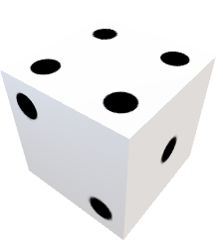
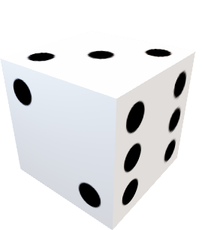
A Simple Architecture: The Craps Table
Initial Objective: Determine the outcome probabilities for a pair of dice
Architectural Model

Slide 5

The Analytic Model
Die 1
Dice Roll Result
Uncertain Events
  Die number 1
  Die number 2
Die 2

Slide 6

Evaluate Uncertainty
MBSE involves selecting the right tool
  Option 1: risk framework

Slide 7

Evaluate Uncertainty
MBSE involves selecting the right tool
  Option 2: Discrete Event Simulation

Slide 8
Evaluate Uncertainty
MBSE involves selecting the right tool
  Option 2: Discrete Event Simulation

Slide 9

Monte Carlo Simulation
How is it different from Discrete Event Simulation?
How does it work?

Slide 10

Monte Carlo Simulation
Still relies on random number generation
Uses probability distributions associated with individual uncertainties
Samples from each uncertainty and provides a result
Repeated many times to develop a distribution of outcomes

Slide 11
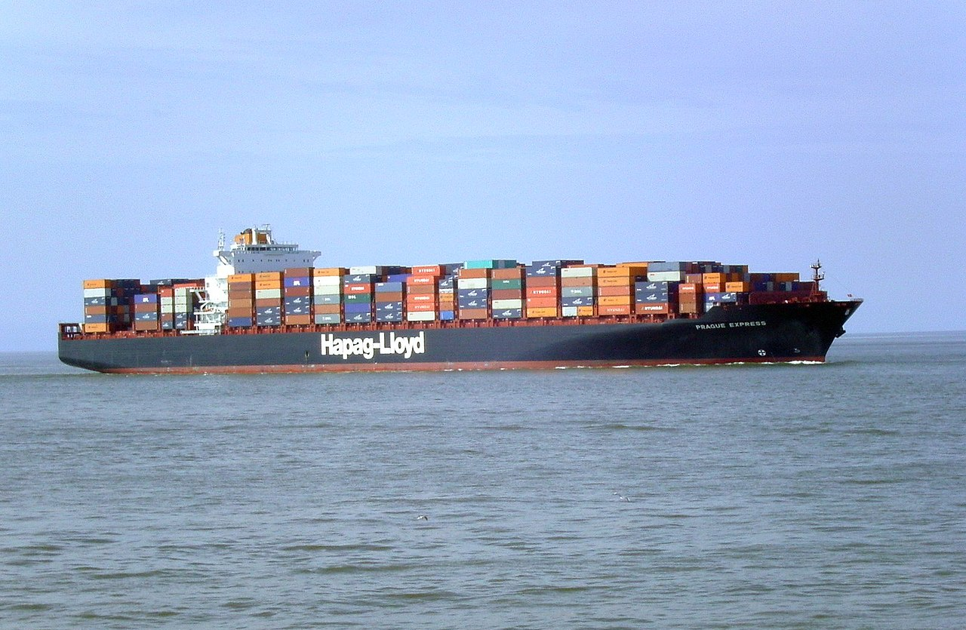
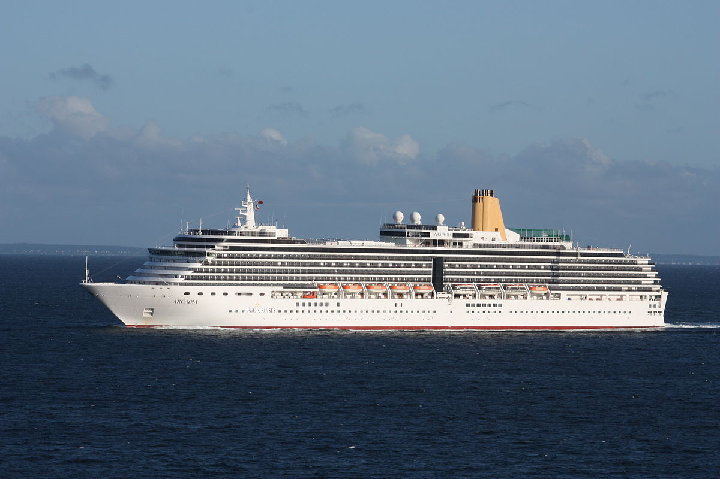

A Monte Carlo Simulation Example
Determine Collision Risk in a sea lane

Slide 12

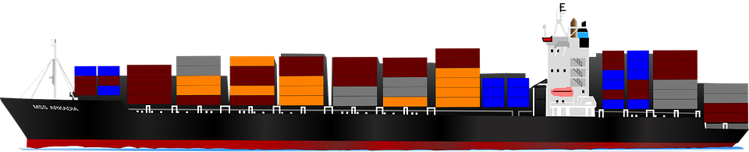
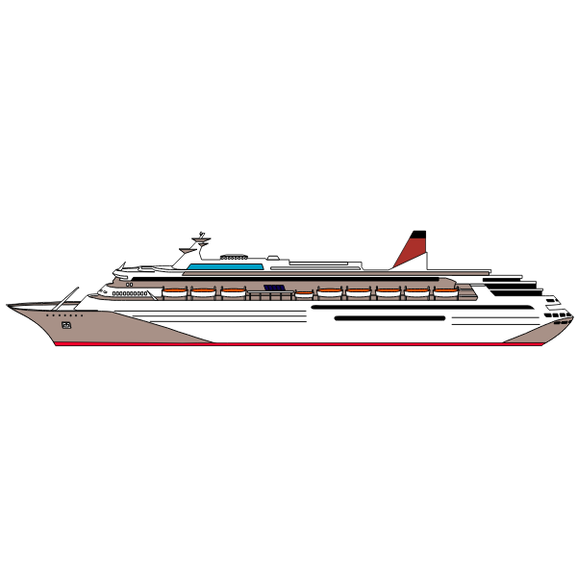
Architectural Model
Ship 1 Navigation Accuracy
Ship 1 Beam
Separation
Ship 2 Beam
Ship 2 Navigation Accuracy
Notes:
Point out additional uncertainties that may exist, such as vessel speed – intentionally ignored to manage demonstration complexity. (if a collision occurs, outcome is probably dependent on speed)

Slide 13
Defining a Collision
Initial Objective: determine probability of collision
Ship 1 Navigation Accuracy
Ship 1 Beam
Clearance
Separation
Ship 2 Beam
Ship 2 Navigation Accuracy

Slide 14

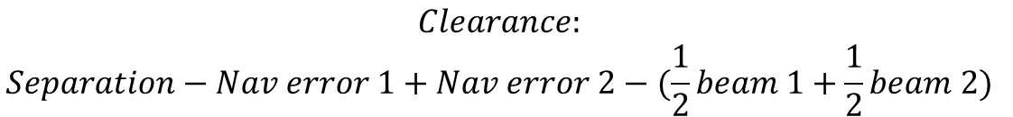
Anatomy of a Collision
½ beam 1
½ beam 2
Nav error 1 (+)
Nav error 2 (-)
Separation = distance between intended tracks
Collision: Clearance <=0
Center of mass 1
Center of mass 1
$$Clearance:$$
$$Separation−Nav error 1+Nav error 2−(\frac{1}{2}beam 1+\frac{1}{2}beam 2)$$
Intended track 1
Intended track 2

Slide 15

Collecting Data
For each uncertainty, collect data and fit to a distribution
  Alternatively, estimate the distribution
Ship 1 Beam
Ship 2 Beam
Ship 1 Navigation Accuracy
Ship 2 Navigation Accuracy

Slide 16

Distribution Fitting

Slide 17
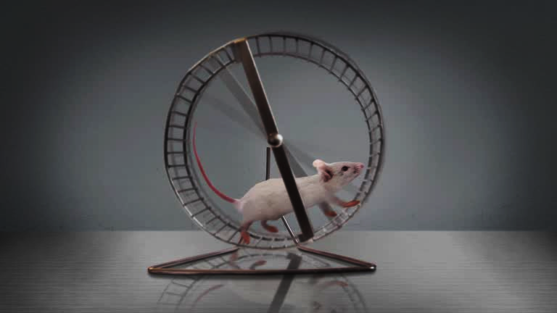
Running the Simulation
Make Separation Decision
  Example: 1,000’
Choose an uncertainty to sample

Slide 18
Running the Simulation
Generate a Random Number
  Example: 0.85
Find the intersection with the CDF
Drop down to the horizontal axis
Read the result: 136’

Slide 19

Running the Simulation
Repeat sampling for each uncertainty
  Example:
    Beam 1: 155’
    Beam 2: 136’
    Nav 1: 90’
    Nav 2: -57’
Determine Clearance
$$Clearance:$$
$$Separation−Nav error 1+Nav error 2−(\frac{1}{2}beam 1+\frac{1}{2}beam 2)$$
1,000’ – 90’ + (-57’) – (77.5’ + 68’) = 707.5’

Slide 20
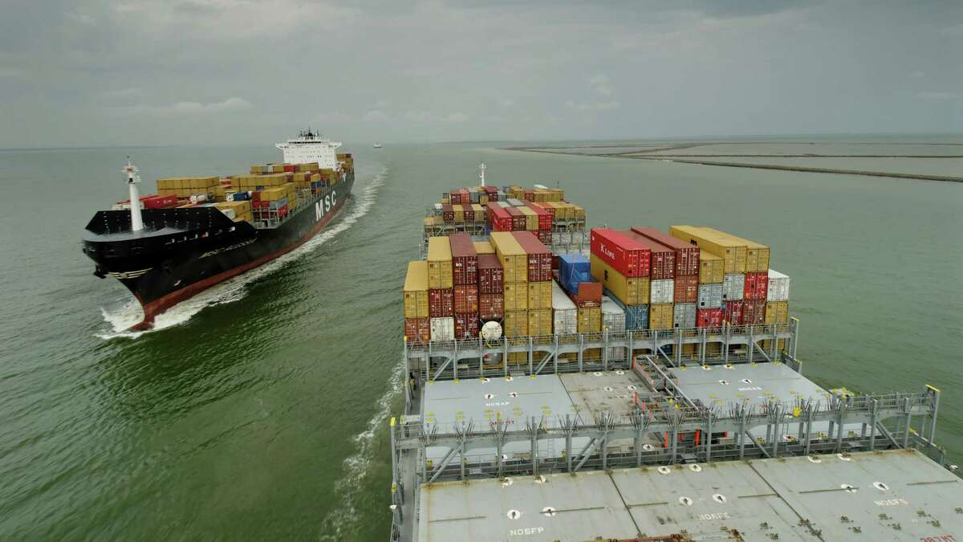
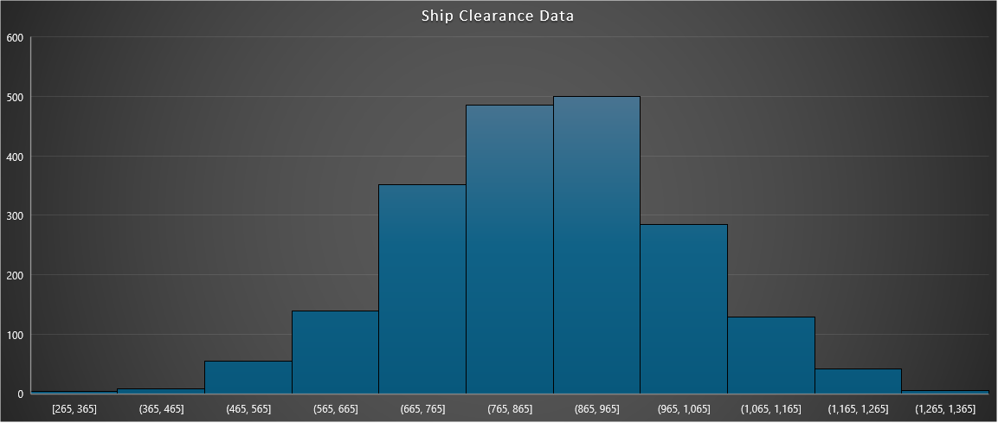
Example Results
Running the simulation thousands of times produces …

Slide 21
Example Results
Separation | Probability of Collision
300’ | 15%
500’ | 0.98%
750’ | 3.2 x 10⁻⁵
1,000 | 7.3 x 10⁻⁹
1,200 | 1.3 x 10⁻¹²
With 1,000’ of Separation …
Minimum observed: 265’
Maximum: 1,325
Probability of Collision: 7.3 x 10⁻⁹

Slide 22

Monte Carlo Simulation in SMS
Requires an automation platform to be feasible
  Example: ANG HEAT application
Augments current data-driven risk analysis capabilities
  Supports hazard analysis with continuous probabilities
    Especially useful for environmental hazards like low visibility, crosswinds, etc
    Can be used with categorical or continuous severity distributions
  Supports occurrence analysis – an undeveloped capability in the SMS
    Probability of an occurrence due to any hazard (or combination of hazards)
      Examples: Probability of collision, NMAC, loss of control, CFIT, wrong surface landing, runway incursion/excursion …

Slide 23
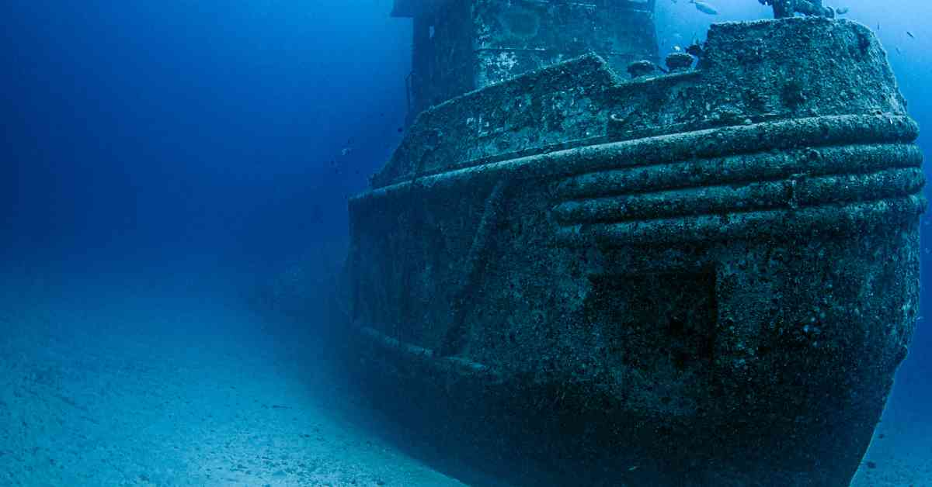
Questions, Discussion

Slide 25
Testing a Random Number Algorithm
Lattice Tests

